Slide 1
High-level Language Programming Project 2021
2021.4.15
Orator: Wenpeng Xiao, Jingjing Ren

Slide 2
Objective
To practice the students' capability of problem analysis and programming skill.
To master the thinking of object-oriented programming, and use idea of object-oriented programming to solve practical problems;
To carry out the programming design and coding independently, and use various ways for debugging and correcting the error efficiently;
To write a scientific report, and hence have a better understanding of the knowledge and to develop students' ability to express and speculative.

Slide 3
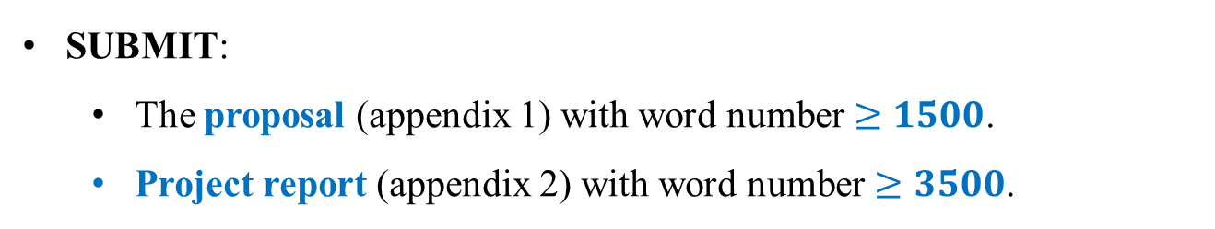
Requirements
3-4 students /group
Each group selects one interesting topic, which is NOT LIMITED to the options provided in this specification.
SUBMIT:
The proposal (appendix 1) with word number $≥1500$.
Project report (appendix 2) with word number $≥3500$.

Slide 4
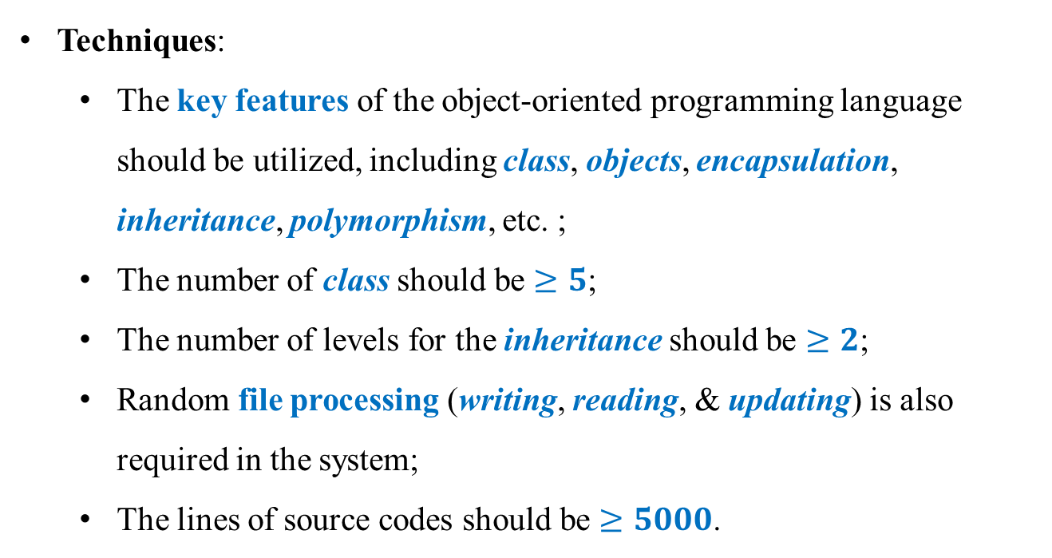
Requirements
Techniques:
The key features of the object-oriented programming language should be utilized, including class, objects, encapsulation, inheritance, polymorphism, etc. ;
The number of class should be $≥5$;
The number of levels for the inheritance should be $≥2$;
Random file processing (writing, reading, & updating) is also required in the system;
The lines of source codes should be $≥5000$.

Slide 5
Requirements
The SYSTEM should be designed and implemented reasonably, efficiently and friendly.
ATTENTION: Source code should be clearly commented:
Comments for class (a detailed description of the properties, behaviors, class inheritance, and derived relationships);
Comment for functions (detailed description of objectives, function parameter, principle steps /algorithms).

Slide 6
Reference Topics
Dibuix
Dibuix is a Catalan word which means drawing, it is a painting application, but can do more than painting.
It includes the basic drawing function components to meet the basic drawing needs of users.
To make the software design novel and innovative, and conform to the characteristics of the AI era, provide functions like face recognition (may even include body recognition) so the software can automatically draw a painting.
Specially, after uploading a picture, the software can recognize the picture intelligently and draw the people inside it with in pixel style.

Slide 7
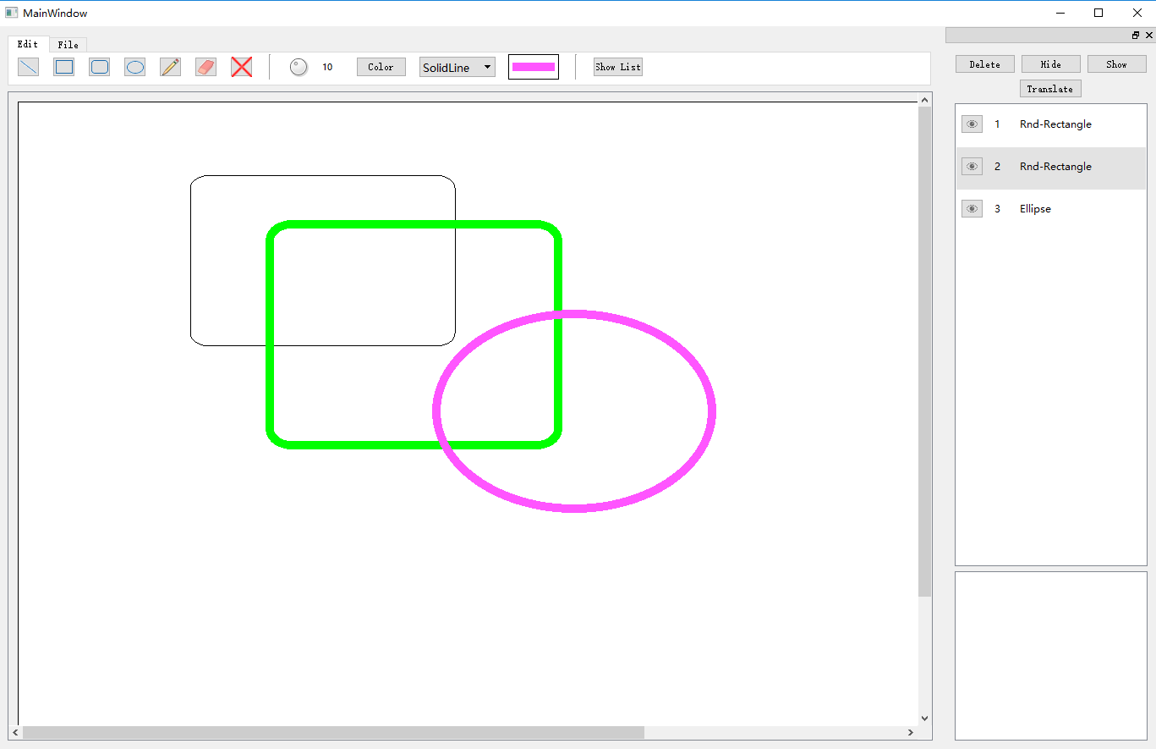
Request:
1) Provide a friendly UI for the system
Hints: MFC, QT, C# can be used

Slide 8
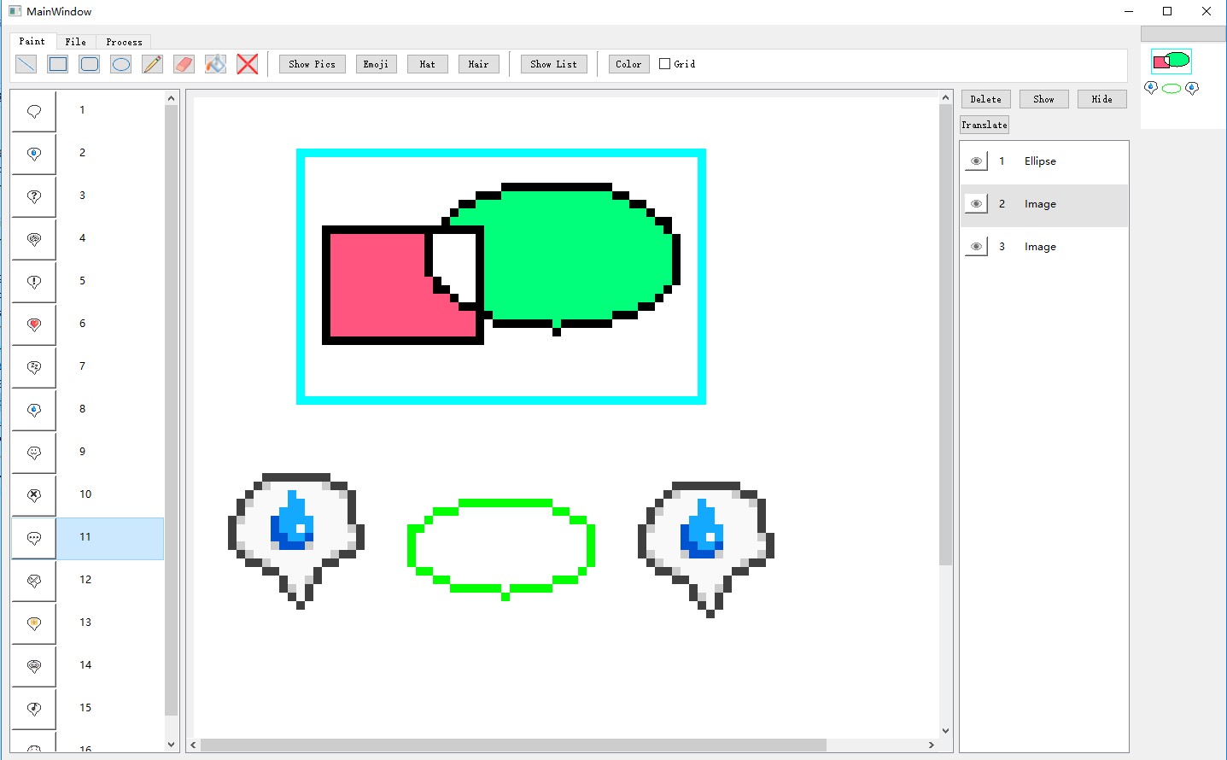
Request:
2) Wizard dialog box for files operations
Tools in tool bar
Overview
Hierarchies
Brushes/Styles/Patterns

Slide 9
Request:
3) Normal painting mode:
Basic shapes drawing
Clear canvas
Pen’s demo canvas
Adjust pen’s properties
Visualize shape list
Hide, show, and delete shape
Translate shape
Visualize adjust list
Outline shape’s range
Save and open picture
4) Pixel art mode:
Basic shapes drawing
Clear canvas
Adjust pen’s properties
Visualize shape list
Hide, show and delete shape
Translate shape
Change previous shape’s color
Fill shape
Existing images for directly drag and draw
Grid mode
Gray mode
Fill shape
Save and open picture
Save and open project file
Adjust brightness
Adjust saturation
Actual-size demo canvas

Slide 10
Reference Topics
Optional Subjects
Bank Account Management System
Note-taking and Schedule Tool
Monopoly (大富翁)
Supermarket Management System
Household Registration Information Management System
Personal Financial Management System
** Other topics with similar difficulty.
Note: The proposal for the selected topics should be submitted before the determination of the topics for the project.

Slide 11
Evaluation Criteria
Full score: 100
Final report: 35%
——Requirements are referred to Appendix 2
Demonstration: 65%
Basic requirements: 55%
Correctness: 30%
Rationality of Design: 10%
User Interface: 15%
Expression clarity: 5%
Additional features for refinement: 5%
——Demonstrate the system using complete and sufficient test cases; all of the output are correct.
——The design of classes and inheritance hierarchy should be able to solve the key issues of the system.
——Clearly express the design ideas, the technical highlights, the final result and experiences.
——Demonstrates the program and able to answer the questions clearly and reasonably.
——Use Friendly and have nice visual effect
Note: If more than two or above students submit the similar or even same source code and report, after careful verification, the students who copy the files from others will be given zero score. Plagiarism is not permitted!

Slide 12
Submission
Proposal
Final Report (electronic version)
Source codes and executable programs

Slide 13
Demo
Dibuix
SMS

Slide 14
Demonstration
18:30-18:42 | Group 12 C | 云帆,唐之凡,池慧洋,史宣莉
18:42-18:54 | Group 13 C | 黄宗达,梁家榕,徐自华,陈庆龙
18:54-19:06 | Group 14 C | 胡筱曼,谭宛儿,陈治帆,吴迪初
19:06-19:18 | Group 15 C | 罗潇轩,任波,杨丰源,黄天牧
19:18-19:30 | Group 16 C | 匡林云,陈骏川,王葳
19:30-19:42 | Group 1 I | ERIC VENANTHEA DENNIS, KEVIN WIJAYA, Ivan Nathan Parmenas
19:42-19:54 | Group 2 I | Christofer Gabriel Pinheiro,Nikola Gligorovski, Shehabeldin Elsoni Mohamed Elagib,Manyewe Tatenda Nyemudzai,Omar Nooruldin Hassan Nooruldin
19:54-20:06 | Group 3 I | Daniel Gonima Bustamante, Louay Ali Dib, Askar Nurassyl, TOUFIQ IMRAN KHOSHNOBISH, Kadamboy sultanmuratov
20:06-20:18 | Group 4 I | Tadessa masresha abel, MOHAMMED Shea yousif, Ishtiaq nur, Zulkarnine Mohammed Shahla
20:18-20:30 | Group 5 I | USMANI MUHAMMAD AWAIS, ASHIKUZZAMAN FAYSAL, Sohaib Ahmed Hasan Ali, Jenkin Zhan
20:30-20:42 | Group 6 I | YUSUF ABDULLAH MOHAMOUD, BAMBA ABDUL AZIZ, MFOY GEOFREY ELIMINATUS TUMAINI, DIALLO THIERNO IBRAHIMA II, MAKANGA MIHINDOU RICK DAMIEN
20:42-20:54 | Group 7 I | KANYAWAT MANAT NURGI DAWIT ABERA GIGI SANKEY
8 min for presentation
7 min for Q&A
18:42-18:54 | Group 2 U | 郭佳鑫,黄璨,黎羿江,林杰龙
18:54-19:06 | Group 3 U | 马泽君,谷弈勋,李宇洲
19:06-19:18 | Group 4 U | 刘博,邱颖,许辉辉
19:18-19:30 | Group 5 C | 黄昆烨,张芸辉,邝涛杰,韦泽晟
19:30-19:42 | Group 6 C | 孙秦,谭经纬,张柳坚,郭泓树
19:42-19:54 | Group 7 C | 彭鹏,李泳,曾理,陈泰佑
19:54-20:06 | Group 8 C | 马泽原,黄梓楷,许跃缤,陈品烨
20:06-20:18 | Group 9 C | 尹燕婷,张蓝月,张洋,周子阳
20:18-20:30 | Group 10 C | 肖土圣,陈秉亮,林师言,黄子浩
20:30-20:42 | Group 11 C | 洪骏,潘金星,谭笑衡,张佳俊
5.29
5.30

